Slide 1

Professional Resources & Review Marketing Research Process

Slide 2
Final Exam …
Tuesday Dec. 8th
In SE6-204
1:00 am – 3:00 pm

Slide 3

The formulation of the problem is often more essential than its solution

Slide 4
Today’s Agenda
Highlight of key Professional Resources
Featured in light blue slides
Special: Panel and Omnibus Research
Marketing Research Process – Review
Focusing on the material from the midterm
Emphasizing the Need-to-Know material

Slide 5
We’ve covered a lot of ground!
Think back to when you developed your proposal …
Let’s look at how much we’ve have covered …

Slide 6
Marketing Research Process
Establish the need for mktg research
Define the problem
Establish research objectives
Determine research design
Identify information types and sources
Determine methods of accessing data
Design data collection forms
Determine sample plan and size
Collect data
Analyze data
Final research report

Slide 7
Chapters
Week | Chapter
8 | Ch. 10
9 | Ch. 11
10 | B2B Research (Not in the text) Ch. 14 (Skip: pg 445-457)
11 | Ch. 12
12 | Ch. 13 (Skip: pg 405-416) Ch. 15

Slide 8
Professional Resources
Featured by light blue background.
A special section on buying Panel Research and Omnibus Research.

Slide 9

Professional Resources
Research firms and data collection companies belong to the Marketing Research and Intelligence Association (www.mria-arim.ca)
If you have budget for market research, this is a great place to start in your search for the right research supplier.

Slide 10

Professional Resources
Secondary Research
Electronic Sources
Statistics Canada
Available through:
Anywhere, Anytime use advanced search strategies with Search Engines such as:
Google
Yahoo

Slide 11


Professional Resources
Quirk’s Marketing Research Review:
Search under “Research Topics” for professional tips on how to:
Conduct Focus Groups
Conduct Telephone Surveys
Set up Mall Intercepts
etc.

Slide 12


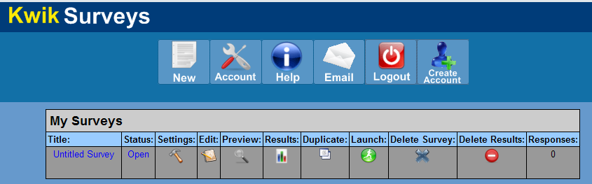
Professional Resources
Free basic subscription (30 Qs, n<100, 10 days)
Pro subscription $199 USD/yr
Free basic subscription (10 Qs, n<100)
Pro subscription $20 USD/month
FREE!
Notes:
If you plan to do any on-line research yourself

Slide 13
Marketing Research Process
Establish the need for mktg research
Define the problem
Establish research objectives
Determine research design
Identify information types and sources
Determine methods of accessing data
Design data collection forms
Determine sample plan and size
Collect data
Analyze data
Final research report

Slide 14

Step 8: Sampling
Week 8
Sample Methods &
Sample Size
Chapter 10

Slide 15
Step 8: Sampling
Sample Plan – describe how each sample element, or unit, is to be drawn from the total population.
Key Concepts:
Sample Method – representativeness
Sample Size – accuracy

Slide 16
Basic Concepts in Sampling
Population:
Entire group under study as defined by research objectives.
Census:
Research of the total population.
Sample:
Subset of the population that should represent the entire group.
Notes:
Reasons for Taking a Sample:
Practical considerations such as cost and population size
Inability of researcher to analyze huge amounts of data generated by census
Samples can produce precise results

Slide 17
Basic Concepts in Sampling
Sampling Frame:
Master list of the entire target population.
Sampling Frame Error:
How much the sample frame fails to account for all of the population.
Ex: Telephone book excludes unlisted numbers and only cell-phones subscribers.
Incidence Rate:
Percentage of people who qualify as members of the population.

Slide 18
Sampling Methods
Probability Samples:
Results can be projected to the population.
Sampling error can be computed.
Non-Probability Samples:
Results can NOT be projected to population.
Sampling error can NOT be computed.

Slide 19
Sampling Methods
Sampling Methods
Probability Samples
Nonprobability Samples
Simple Random
Systematic
Convenience
(incl. Mall Intercept)
Judgment
Stratified
Cluster
Snowball
Quota

Slide 20
Stratified Random Sampling
Divide target population into groups (Strata).
Random selection within each group.
Ex: Small, Medium Large customers.
S₁
S₃
M₁
M₃
L₁
L₃
Population
S₂
M₂
L₂
Random Selection from each group
Sample
S₃
M₁
L₂

Slide 21
Online Sampling Techniques
Random Website Intercept Sampling
Random sample if population is website visitors.
Otherwise non-probability sample, like intercept.
Invitation Online Sampling
Sample frame ex: emails of customers.
Online Panel Sampling
Developed by research companies to conduct surveys with (almost) representative samples.
NOT a probability sample, but very high level of representativeness.

Slide 22
Errors in Sampling
Sampling Error:
Any error in a survey that occurs because a sample is used.
Probability samples: can be measured.
Sampling Frame Error:
How incomplete is the master list?

Slide 23

Margin of Error Statements
Ex: Margin of error for a 600 sample survey is
+4%, 19 times out of 20.
CAUTION:
Only relevant for
Probability Samples!
Confidence Interval (95%)
Sample Error

Slide 24
Sample Size Calculation
Confidence Interval Approach:
Variability:
How similar the responses are: [p*q] or [SD].
Confidence Interval:
95% (z=1.96) or 99% (z=2.58)
Accuracy:
Allowable Sample Error + X%.
… to create a “correct” sample size.
Notes:
SD = Standard Deviation

Slide 25

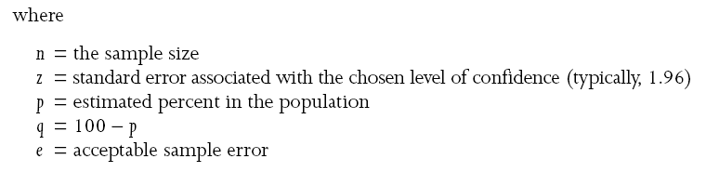
Sample Size Formula
Standard sample size formula for estimating a percentage:
Population Size is NOT in the formula
Notes:
25
Fortunately, statisticians have given us a formula which is based upon these relationships.
The formula requires that we
Estimate the variability in the population
Specify the amount of confidence we wish
Specify the amount of desired accuracy (error)
When we specify the above, the formula tells us what sample size (n) we need to use.

Slide 26
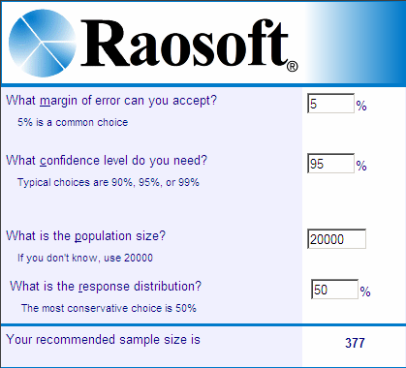
Professional Resources
Notes:
http://www.raosoft.com/samplesize.html

Slide 27
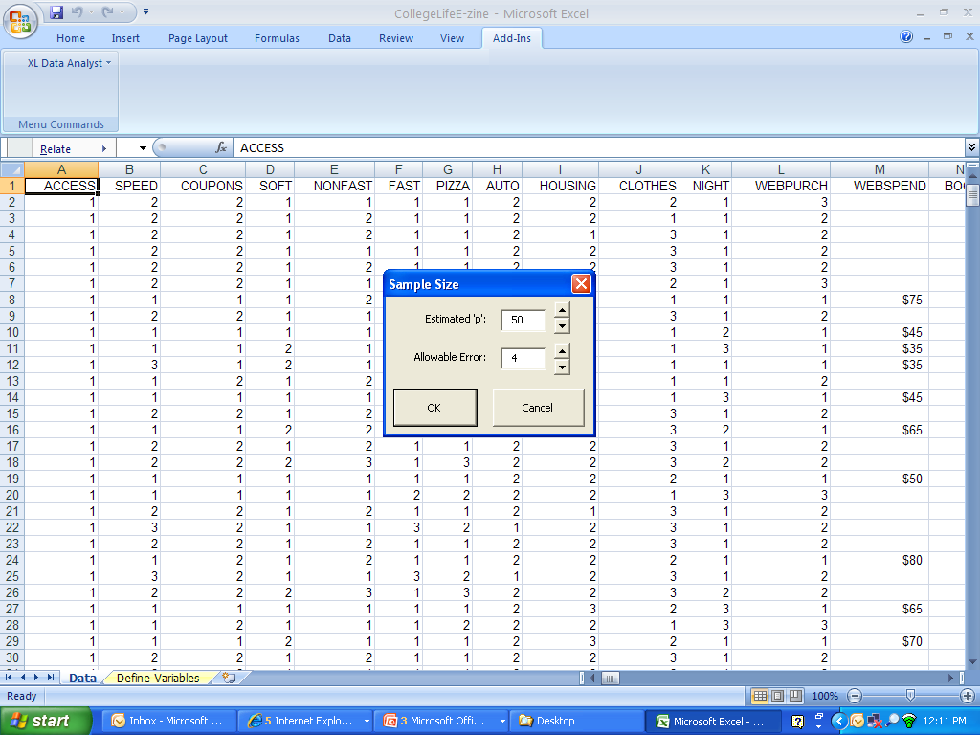
Professional Resources
XLDA Sample Size Calculator:
Remember:
If you don’t know the variability use the ‘worst case’ scenario of p=50
XLDA refers to ‘sample error’ as ‘allowable error

Slide 28
Professional Resources
Panel Suppliers

Slide 29

Professional Resources
Panel Suppliers
Panel companies recruit people for inclusion on their panels.
Panel members are paid for their participation.
At the time of recruitment, a lot of demographic information is collected.
Notes:
This allows the panel company to quickly identify the members who are eligible to participate in any one survey.

Slide 30

Professional Resources
Panel Suppliers
Panel companies charge per complete survey.
Prices vary widely and are dependent on the incidence rate of the population required.
General population costs average about $10-$15 per completed for a 7-8 minute questionnaire and go up from there.

Slide 31





Professional Resources
Panel Suppliers
Notes:
GMI (http://www.gmi-mr.com/): although they are based in Seattle, they have a strong panel in Canada, and apparently they are one of the most competitive with their prices.
Greenfield (www.greenfield.com)
SSI (www.surveysampling.com) The way it works is that they will give you a quote on completed surveys based on your sample definition. Before you phone, you need to think about the definition of the target market and sample. You can ask for any sample size by segment (in essence a stratified sample - some call that quotas). For example, you can ask for X males 25-35, Y females 25-35, Z females 35-45 etc. You will narrow the exact definition of the target market once you have completed the focus groups, so at this stage just get enough pricing information to put a budget together for the proposal

Slide 32

Professional Resources
Omnibus Surveys
Omnibus Surveys:
Allow you to purchase questions on a shared-cost survey rather than having to commission a custom survey.
Usually run on a monthly
or bi-monthly basis.

Slide 33

Professional Resources
Omnibus Surveys
Most are provincial in scope, some are national.
Most sample sizes vary from 500 to 1,000.
Most are general population samples, but some survey unique populations, such as youth.

Slide 34


Professional Resources
Omnibus Surveys
Offered by most major marketing research companies…
Notes:
www.ipsos.ca
www.synovate.com
www.tns-cf.com
www.mustelgroup.com

Slide 35
Professional Resources
Omnibus Surveys
Omnibus Surveys: Costs
Costs vary by type of question asked.
Open-ended questions are the most expensive.
Item bank questions are the least expensive.

Slide 36

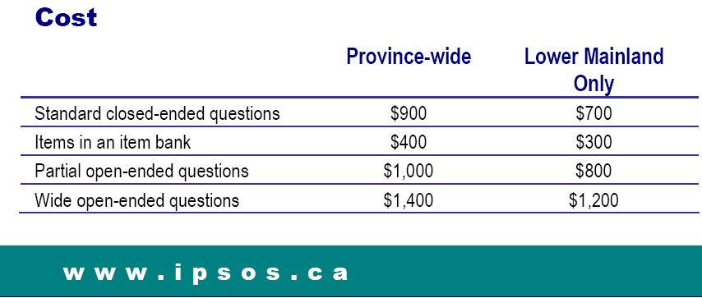
Professional Resources
Omnibus Surveys
Notes:
Ipsos Reid is Canada’s market intelligence leader. With operations in seven cities, Ipsos Reid employs more than 400 researchers and support staff in Canada. The company has the biggest network of telephone call centres in Canada, as well as the largest prerecruited household and online panels. Ipsos Reid’s marketing research and public affairs practices are staffed with seasoned research consultants, with extensive industry-specific backgrounds, offering the premier suite of custom and syndicated research vehicles in Canada. Ipsos Reid is a member of the Ipsos Group, a leading global surveybased market research group. To learn more, visit www.ipsos.ca.

Slide 37
Marketing Research Process
Establish the need for mktg research
Define the problem
Establish research objectives
Determine research design
Identify information types and sources
Determine methods of accessing data
Design data collection forms
Determine sample plan and size
Collect data
Analyze data
Final research report

Slide 38
Step 9: Collect Data
Week 9
Data Collection Summarizing
Findings
Chapter 11

Slide 39
Step 9: Collect Data
Non-Sampling Errors:
Data analysis cannot fix bad data.
Non-sampling errors are caused by:
Errors by fieldworkers or respondents.
Can be intentional or unintentional.
Managing Non-sampling errors:
Can only be minimized by controls.
Can not be measured.

Slide 40
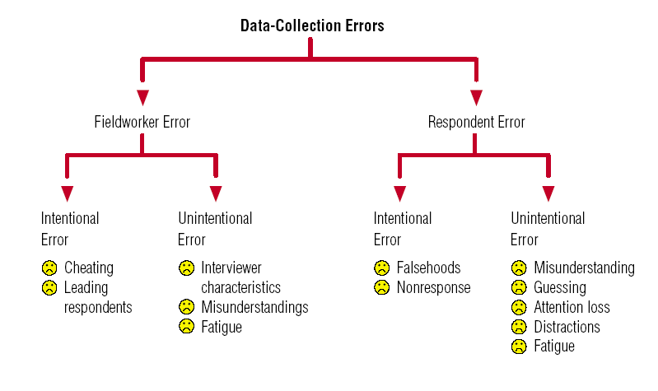
Data Collection Errors

Slide 41
Marketing Research Process
Establish the need for mktg research
Define the problem
Establish research objectives
Determine research design
Identify information types and sources
Determine methods of accessing data
Design data collection forms
Determine sample plan and size
Collect data
Analyze data
Final research report

Slide 42
Step 10: Analyze Data
Data must be transferred from the data collection forms (e.g., questionnaire) to analysis software (e.g., XLDA).
Data cleaning – inspecting data for errors.
Data analysis – statistical analysis.

Slide 43
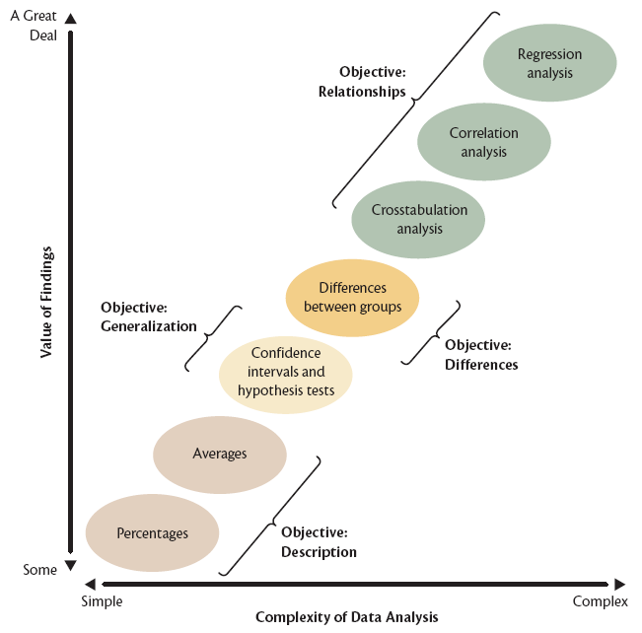
Levels of Analysis

Slide 44
Types of Data Analyses
Description
Data summarization and simple description.
Generalization
Project the sample findings to the population.
Differences
Detect differences in responses.
Relationships
Determine relationships between variables.
Table 11.3
Notes:
44
See Figure 11.3

Slide 45
Statistical Analyses
Statistical Analyses used in your projects:
Summarize (Ch11)
Categorical: Percent
Metric: Average
Multiple Response
Relate (Ch14)
Two Categorical: Cross-tabulations
Two Metric: Correlation Coefficient

Slide 46
Summarize the Data
Categorical: Percents
Group the related variables in each run.
Ex. Percent of all demographic variables producing “Respondent Profile”.
Metric: Averages
Group the related variables in each run.
Ex. Include all the categories in one Grid question into one run (creating one table).
Notes:
46

Slide 47
Characteristics of Single Variables
Central Tendency
The ‘typical’ respondent (ex: average age).
Measures: Mean, Median, Mode
Variability
Dispersion, the ‘spread’ of values.
Measures: Standard Deviation, Variability (p*q), Range (highest-lowest)

Slide 48
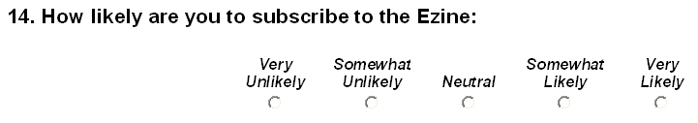
Q Type, Measurement, Analysis
Please indicate your academic classification:
Freshman
Sophomore
Junior
Senior
Categorical
Percent
What is your GPA? _____
Metric
Average
Metric
Average

Slide 49
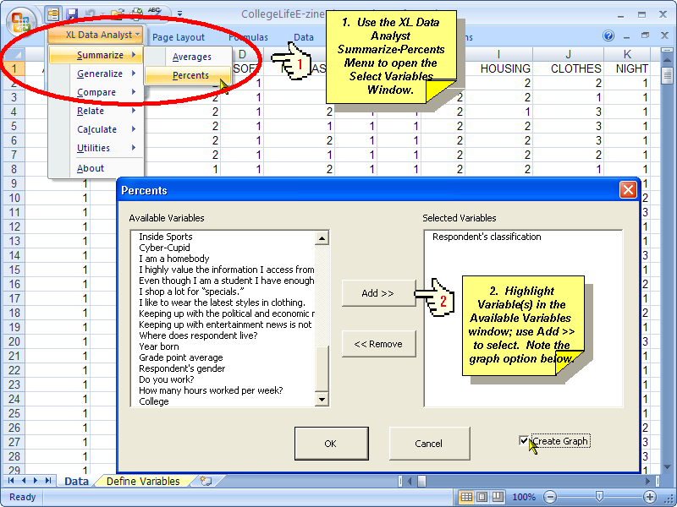
XLDA: Summarize
Categorical Variables
Notes:
PC Lab 8
49

Slide 50
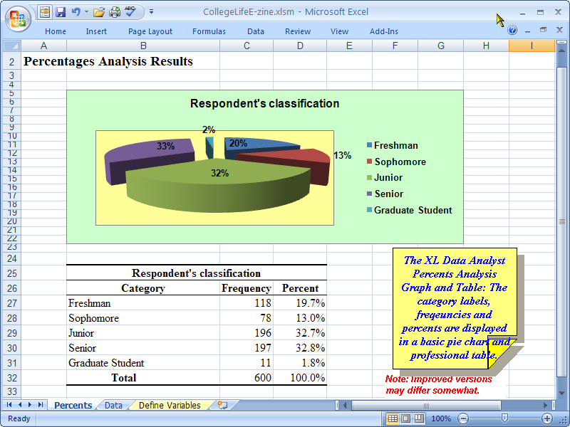
XLDA: Summarize
Categorical Variables
Notes:
50

Slide 51
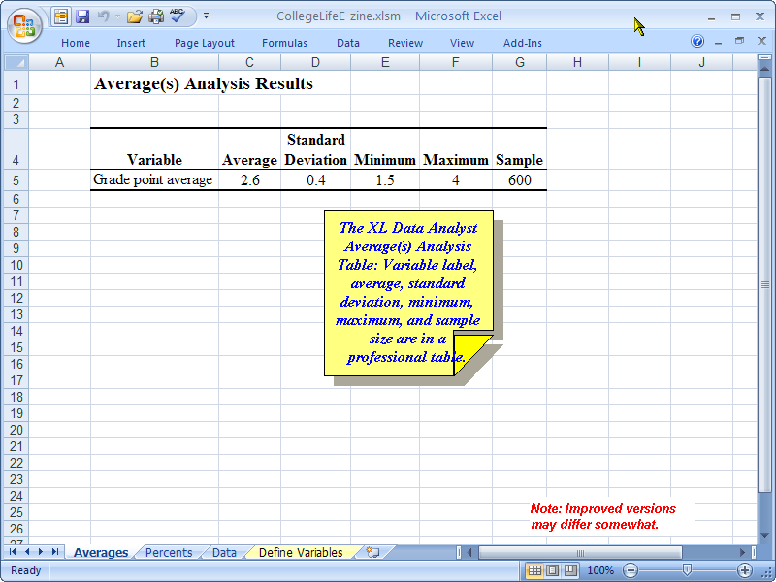
XLDA: Summarize
Metric Variables
Metric Variable:
Q41 What is your Grade Point Average?
Notes:
51

Slide 52
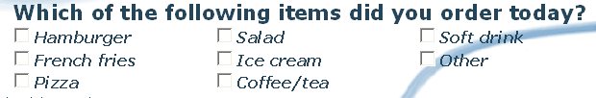
Q Type, Measurement, Analysis
Type of Question: | Multiple Response Qs
Measurement: | Categorical (0,1)
Analysis: | SNAP: MR Tables

Slide 53
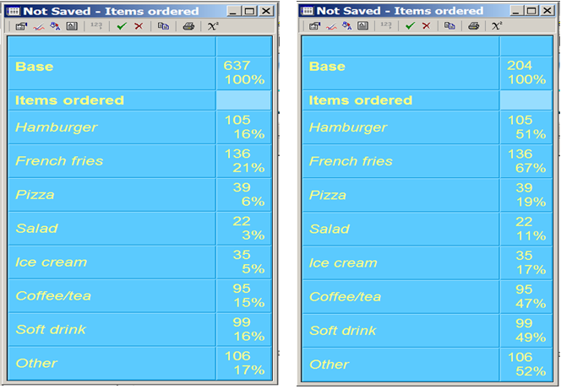
Multiple Response
Notes:
CL Lab 10

Slide 54
Going Back to: Step 9: Collect Data
Week 10
1st half of wk 10 lecture
B2B Res
Not in the text

Slide 55
B2B Research on two levels
Marketing Research Co
Client Company
B2B
Business Flow
Respondents:
Customer Companies
Research Flow
B2C
Respondents:
Final Consumers

Slide 56

B2B Markets
Standardized commodity markets:
Research designs can resemble B2C.
Custom design or engineering markets:
Relationships based on specialty knowledge
B2B research tailored to each situation.

Slide 57
B2B Research Characteristics
Sampling Characteristics:
Small target population: at times a census.
Small sample sizes.
Sample a large % of the population.
Often lack of reliable sample frame.
Respondents Characteristics:
Respondents often geographically dispersed.
Respondents have very busy schedules.

Slide 58
B2B Research Characteristics
Cost Characteristics:
Incentives are common.
Cost/interview higher than B2C.
Business Characteristics:
Average B2B customer often represents large sales volume.
Relationship with B2B customers crucial.
Sales persons may be involved in customer contact and data collection.

Slide 59
Best Practices: B2B Research
8
Foster customer relationships.
Multiple contacts in client co.
Multiple levels in customer co.
Inform all staff in client co.
Expect challenges in compiling sample frame.
Creative interview & com. methods
Specially trained interviewers.
Questionnaire for busy respondents.

Slide 60
Step 10: Analyze Data
Week 10
2nd half of wk 10 lecture
Chapter 14
Crosstabs
Correlations

Slide 61
Associations among Variables
Two Categorical var: Crosstabs & Chi-square
Two Metric var: Correlation & sig.
Regardless of type of variable, we evaluate the relationship in terms of:
Presence
Strength
Direction
?
?

Slide 62
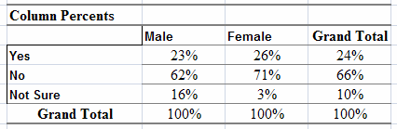
Constructing Crosstabs
Columns: Independent
Ex: demographics
Rows: Dependent
Ex: rating, purchase

Slide 63
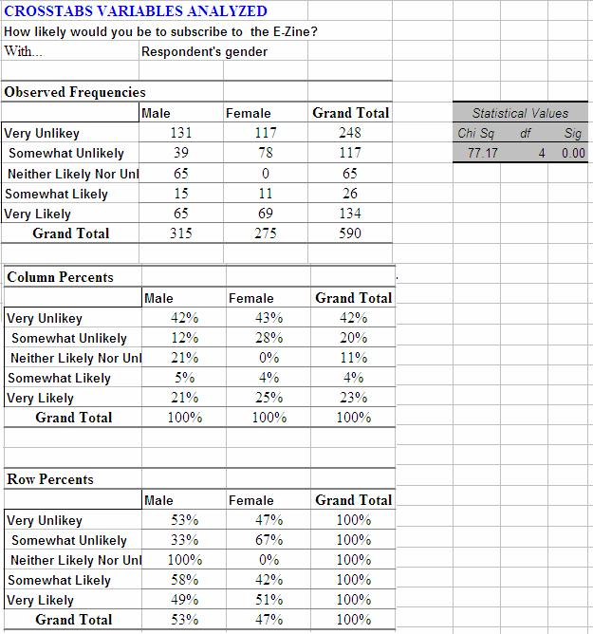
Step 1: Significant?
0.05 < sig
If not, don’t analyze
Step 2: Trends?
Analyze Col. Pct. Across the rows

Slide 64
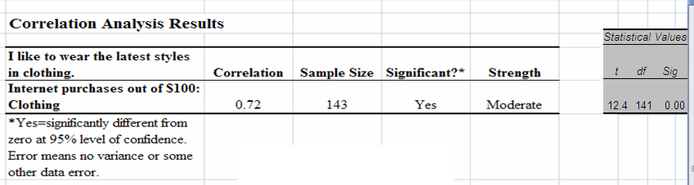

XLDA: Correlation Analysis
Step 2: Correlation Coeff?
Strength & Direction
Step 1: Significant?
0.05 < sig
The closer ‘r’ is to +1.0 the stronger the relationship.
Notes:
64

Slide 65
Step 10 continued: More Analysis of Data
Week 11
Chapter 12
Confidence Interval
Generalize
&
Hypothesis Testing

Slide 66
Generalization
Population Fact: the true value when a census of the population is taken.
Sample findings: estimates of population facts, but contain sample errors.
Generalize: we project the findings onto the entire target population.
ONLY for Probability Samples!
Notes:
66

Slide 67
Confidence Interval
A range (lower and upper boundary) into which the researcher believes the population parameter falls with a degree of confidence.
Confidence Interval: expressed as ± X%.
Industry standard: ± 5%.
Notes:
67

Slide 68
Level of Confidence
If you took many, many samples and plotted your percentage, this sampling distribution would look like a bell-shaped curve.
95% of your findings would fall between ± 1.96 * [standard error of the percent]
Level of Confidence: we are 95% confident that the population percent falls in the ± X% confidence interval.
Notes:
68

Slide 69
Hypothesis
Hypothesis:
a statement about the population parameter based on prior knowledge, assumptions, etc.
Null Hypothesis H₀:
no difference between the hypothesized value and the value found in the sample.
Hypothesis Test:
Compare hypothesize value with sample value using significance test.

Slide 70
Generalization & Hypothesis
Generalization:
With Probability Sample, we can generalize the sample findings to the target population.
Different formulas for Categorical and Metric data.
Testing a Hypothesis:
With Probability Sample, we can test a hypothesis against sample findings.
Different formulas for Categorical and Metric data.
Notes:
70

Slide 71
Step 10 continued: More Analysis of Data
Week 12
1st half of wk 12 lecture
Chapter 13
Significance Testing for Differences.

Slide 72
Differences must be:
Statistically significant
Meaningful
Stable over time
Actionable
Statistical issue: Use XLDA to test
Not statistical issue: Judgment by the Marketing Manager

Slide 73
Statistical Significance
Significance (sig.) the flip-side of Level of Confidence.
Sig.=.05 ➔ Level of Confidence = 95%

Slide 74
Tests for Significance
Significant test to use depends on:
The level of measurement.
The number of groups being compared.
The sample size.
XLDA chooses the statistical test for us

Slide 75
Comparing Differences
Compare two groups w t-test or Z-test:
Compare Percent (Categorical)
Ex: Compare two groups (Men/Women) Buy Snacks (Yes/No).
Compare Average (Metric)
Ex: Compare two groups (Men/Women) Rate Happiness(1-5 rating scale).
One Categorical compared to
Another Categorical
One Categorical compared to
One Metric
Notes:
Skip:
Comparing Averages for 3+ groups [ANOVA]
Comparing Variable Averages.
75

Slide 76
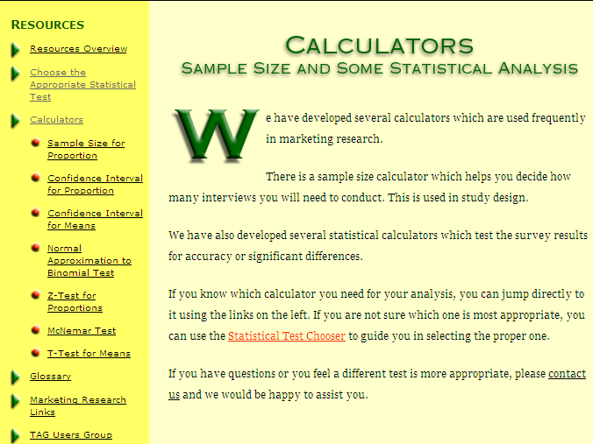
Professional Resources
Notes:
Online calculator: http://www.dimensionresearch.com/resources/calculators.html

Slide 77
Step 10 continued: More Analysis of Data
Week 12
Chapter 15
Research Report
2nd half of wk 12 lecture

Slide 78
Marketing Research Process
Establish the need for mktg research
Define the problem
Establish research objectives
Determine research design
Identify information types and sources
Determine methods of accessing data
Design data collection forms
Determine sample plan and size
Collect data
Analyze data
Final research report

Slide 79

Step 11: Prepare and Present the Final Research Report
Typically there is a written report and an oral presentation to the client and staff.
The report often is the only record of the research project for the client.

Slide 80
Research Report
Components of the research report:
Front Matter, Body, End Matter
Guidelines for effective report writing:
Follow the Project Handout!
For each type of research: group the data analysis by Research Objectives.
Use visuals in the report when possible.
Guidelines for Oral Presentation.
Notes:
80

Slide 81
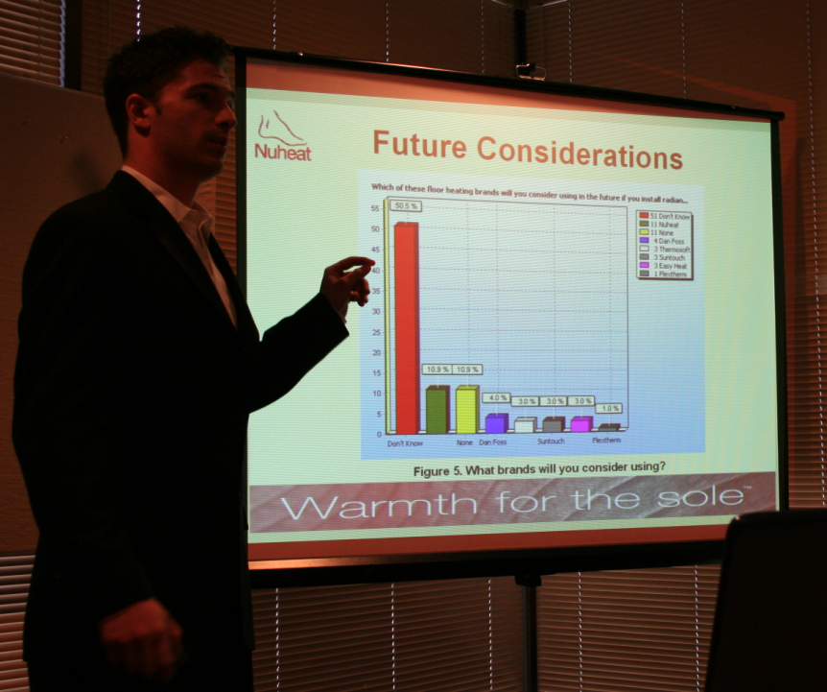
MRIA 2007 winning team Presentation

Slide 82

You & Research
Many of you will become purchasers of research.
Use the Professional Resources.
All of you will become users of research.

Slide 83
You & Research
In this course, you have been taught the skills for all three situations.
You have learned how to conduct Secondary, Qualitative and Quantitative Research.
You know what it takes to produce good research.
You have the skills to critically evaluate research.

Slide 84

The End
Good luck on the Final Exam!

